Slide 1
Reward-Oriented Task Offloading Under Limited Edge Server Power for Multiaccess Edge Computing Minseok Song , Yeongju Lee and Kyungmin Kim
TEAM 13
Adarssh KG :CB.SC.U4CSE23658
Ravindran G :CB.SC.U4CSE23647
Pratyush Yadav :CB.SC.U4CSE23641
Paarthu Reddy :CB.SC.U4CSE23639
Sanjesh Nandha K :CB.SC.U4CSE23242
Deepak S :CB.SC.U4CSE23267

Slide 2
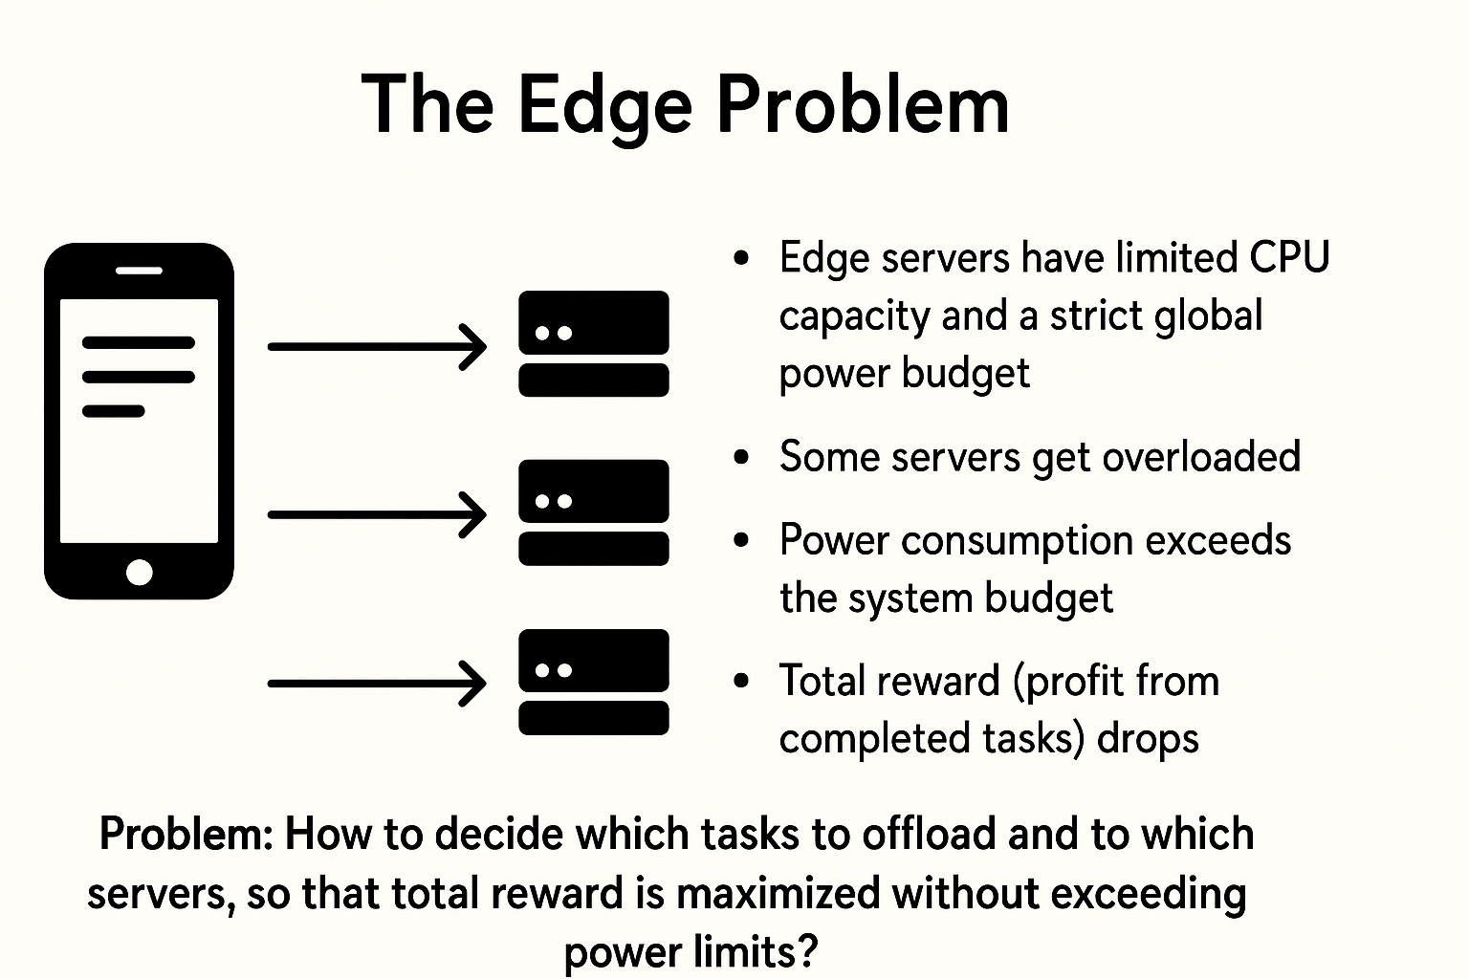
What is the problem??
Mobile/IoT devices generate huge workloads that must be offloaded to edge servers.
Edge servers have limited CPU capacity and a strict global power budget.
If tasks are offloaded without considering power →
Some servers get overloaded.
Power consumption exceeds the system budget.
Total reward (profit from completed tasks) drops.
Problem: How to decide which tasks to offload and to which servers, so that total reward is maximized without exceeding power limits?

Slide 3


Two-phase SOLUTION
PHASE-1
PHASE-2
Calculate how much workload (utilization cap) each server can handle under the global power budget.
Uses reward-to-power efficiency to set these caps.
Assign tasks to servers within the given caps.
Formulated as a Minimum Cost Maximum Flow (MCMF) problem.
Two approaches: EAA-NTS (no task split) and EAA-TS (with task split).
WHY
??
Provides a realistic simulation of task arrivals, server workloads
Ability to track resource usage and power consumption
Let's us test and compare algorithms (MUD, EAA, CI) under controlled scenarios.

Slide 4


workflow
System modelling
Defining edge servers' specifications and tasks
Phase 1
MUD algorithm implementation
Phase 2
EAP algorithm implementation
Final implementation
Final result through simulation

Slide 5
Implementation strategy:
mud.py → Phase 1 algorithm: finds max utilization caps for each server under the global power budget.
eaa_nts.py → Task selection policy (which tasks should be offloaded).
eaa_ts.py → Server selection policy (which edge server executes each task).
main.py → Integrates everything with EdgeSimPy:
Defines the environment (tasks, servers, events).
Applies MUD for utilization caps.
Uses EAA-NTS and EAA-TS for final task offloading.
Runs the simulation and outputs performance metrics (reward, utilization, power).

Slide 6
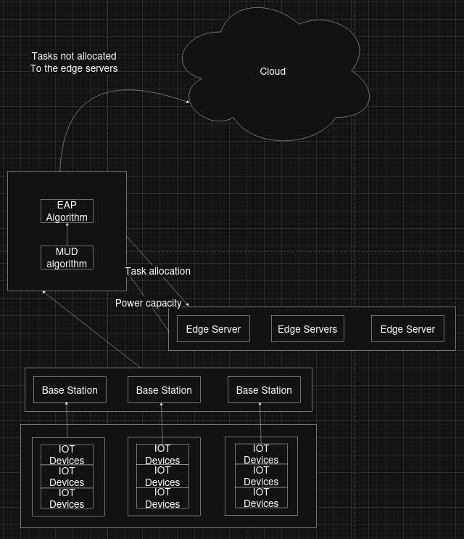
Architecture diagram
IoT devices generate tasks that are processed by nearby edge servers. The MUD algorithm selects suitable servers based on utility and resources, while the EAP algorithm optimizes energy and performance. Tasks that cannot be handled locally are offloaded to the cloud. This ensures low latency, balanced workload, and efficient energy use.

Slide 7
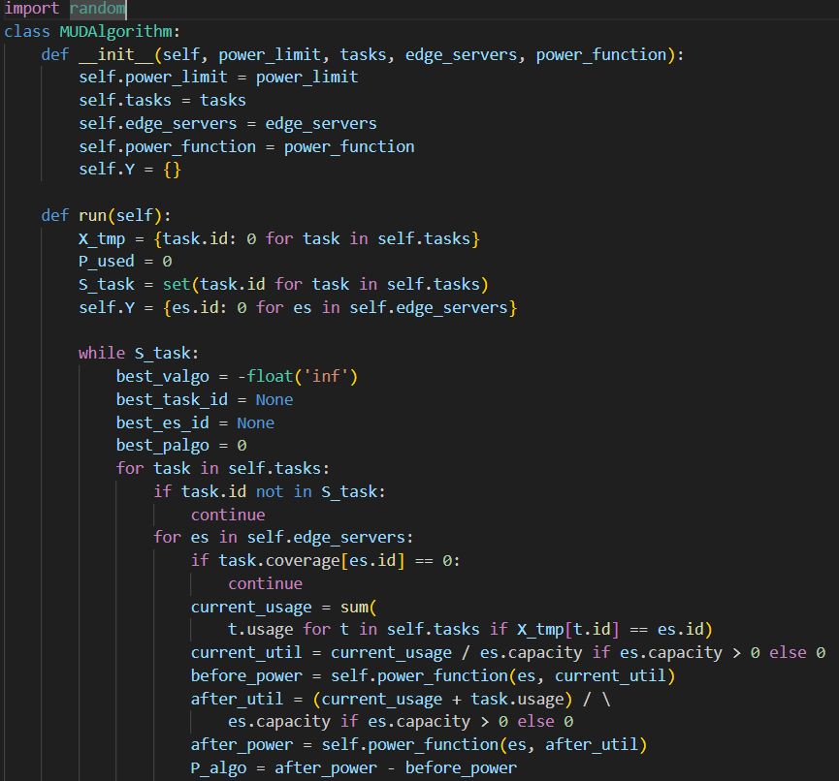
MUD algorithm
Set all servers’ utilization to zero and calculate idle system power.
We search while tasks remain and power ≤ budget, search feasible assignments.
For each task–server pair, reward-to-power efficiency is calculate.
Limits each server’s CPU usage to stay within total power cap. Power capping is the process of setting a maximum limit on the power consumption of a system to prevent overuse and ensure stable operation.

Slide 8
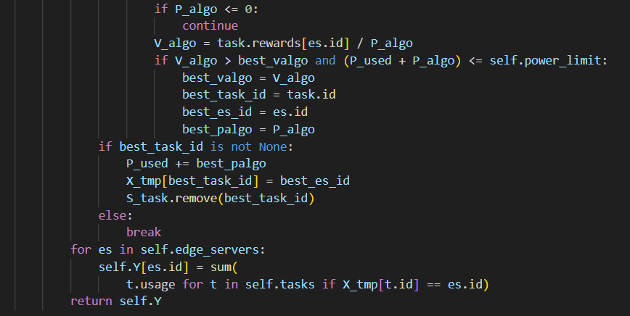
CONT...
It calculates how much extra power the server ould use if the task is added, and then divides the task’s reward by this power increase. This gives a reward-per-power ratio.
The algorithm always picks the task–server pair with the highest ratio.

Slide 9
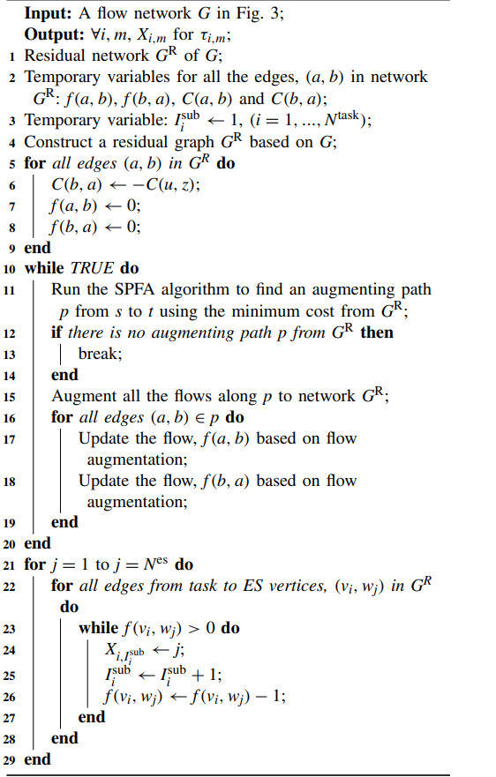
EAA with Task Split
Objective : Maximize total reward from offloading by choosing where each task runs, under per‑server utilization caps derived from power limits and radio coverage constraints
Convert reward maximization into a minimum‑cost flow by putting negative unit reward on task to server edges, so minimizing cost equals maximizing reward.
Task splitting is enabled naturally because a task node can send up to its usage across multiple outgoing edges to different ESs if that increases total reward within capacities.

Slide 10
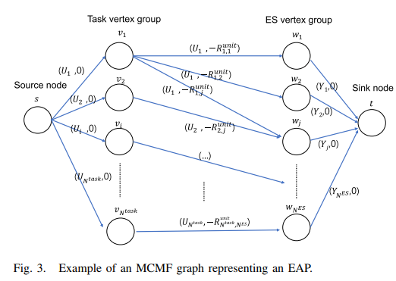
What is this MCMF graph ? How is it built ?
1) The source vertex s is connected to all the task vertexes v1,..., vN task . Each edge (s, vi) has a capacity Ui and a cost of 0.
2) Each vertex vi, (i = 1,...,N task) is connected to the vertices wj for which Hi,j = 1. Each edge (vi,wj) has a capacity Ui and a cost, −Runit i,j .
3) Each vertex wj, (j = 1,...,N ES) is connected to the sink vertex t. Each edge (wj, t) has a capacity Yj and a cost of 0.

Slide 11
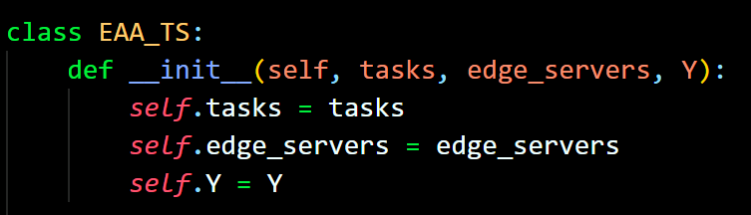

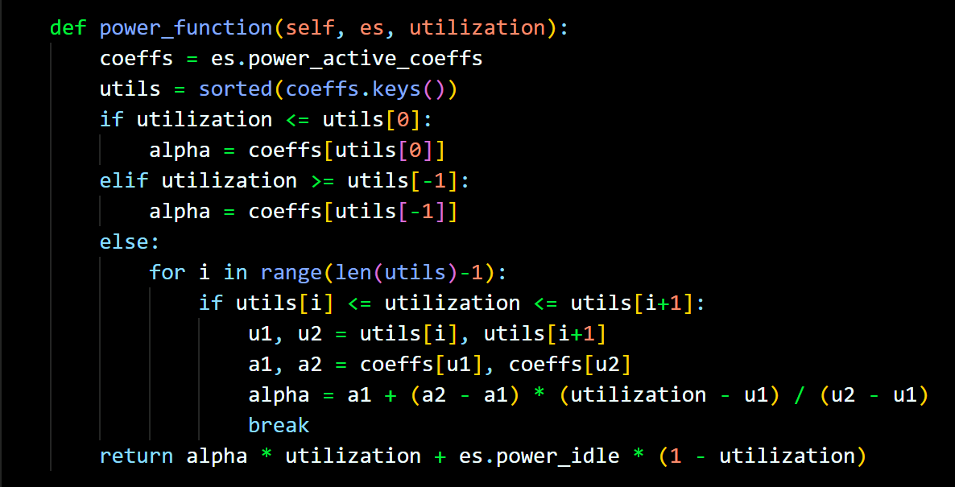
Edge allocation algorithm(ts)
Loads tasks, edge servers, and their capacity limits (Y).
Prepares for allocation with task splitting allowed.
Estimates server power consumption at a given utilization.
Uses interpolation between known power values.
Ensures allocation respects energy constraints.

Slide 12
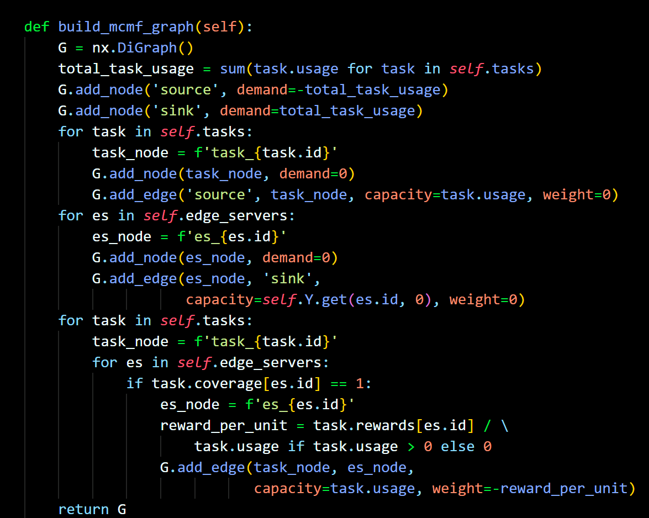

Edge allocation algo (ts)
This Builds a Min-Cost Max-Flow graph
Nodes:
Source → all tasks start here.
Tasks → represent workloads to be assigned.
Edge Servers → where tasks can be placed.
Sink → collects all assigned workloads.
Edges:
Show which task can go to which server.
Capacities = how much work can flow (task usage & server limits Y).
Weights = – reward per unit (so the solver tries to maximize reward by minimizing cost).
What this function Does ??
The MCMF algorithm sends workload “flow” through the graph.
It determines how much of each task is assigned to each server.
Tasks may be split across servers if required.
The final allocation maximizes total reward while respecting server capacities and the overall power budget.

Slide 13
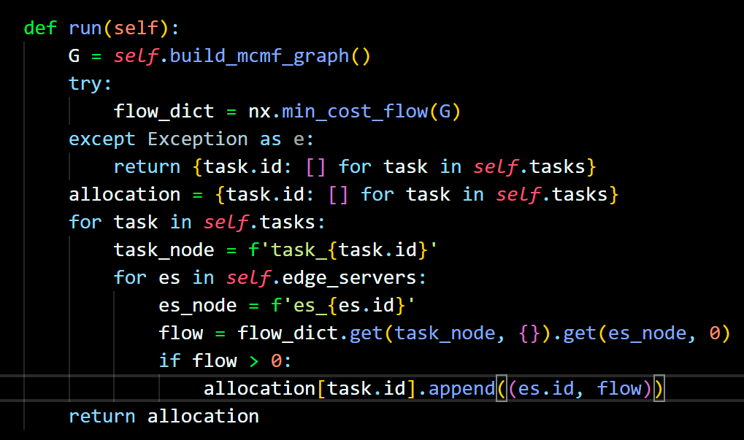

Edge allocation algo (ts)
Runs min-cost flow solver from NetworkX.
If successful → gets the optimal allocation of tasks across servers.
Each task may be split across multiple servers if needed.
If solver fails → returns empty allocations
What's NetworkX?
A Python library for creating and analyzing graphs and networks.
Let’s you easily build nodes & edges, then run algorithms on them.
Provides ready-to-use solvers like Min-Cost Max-Flow

Slide 14
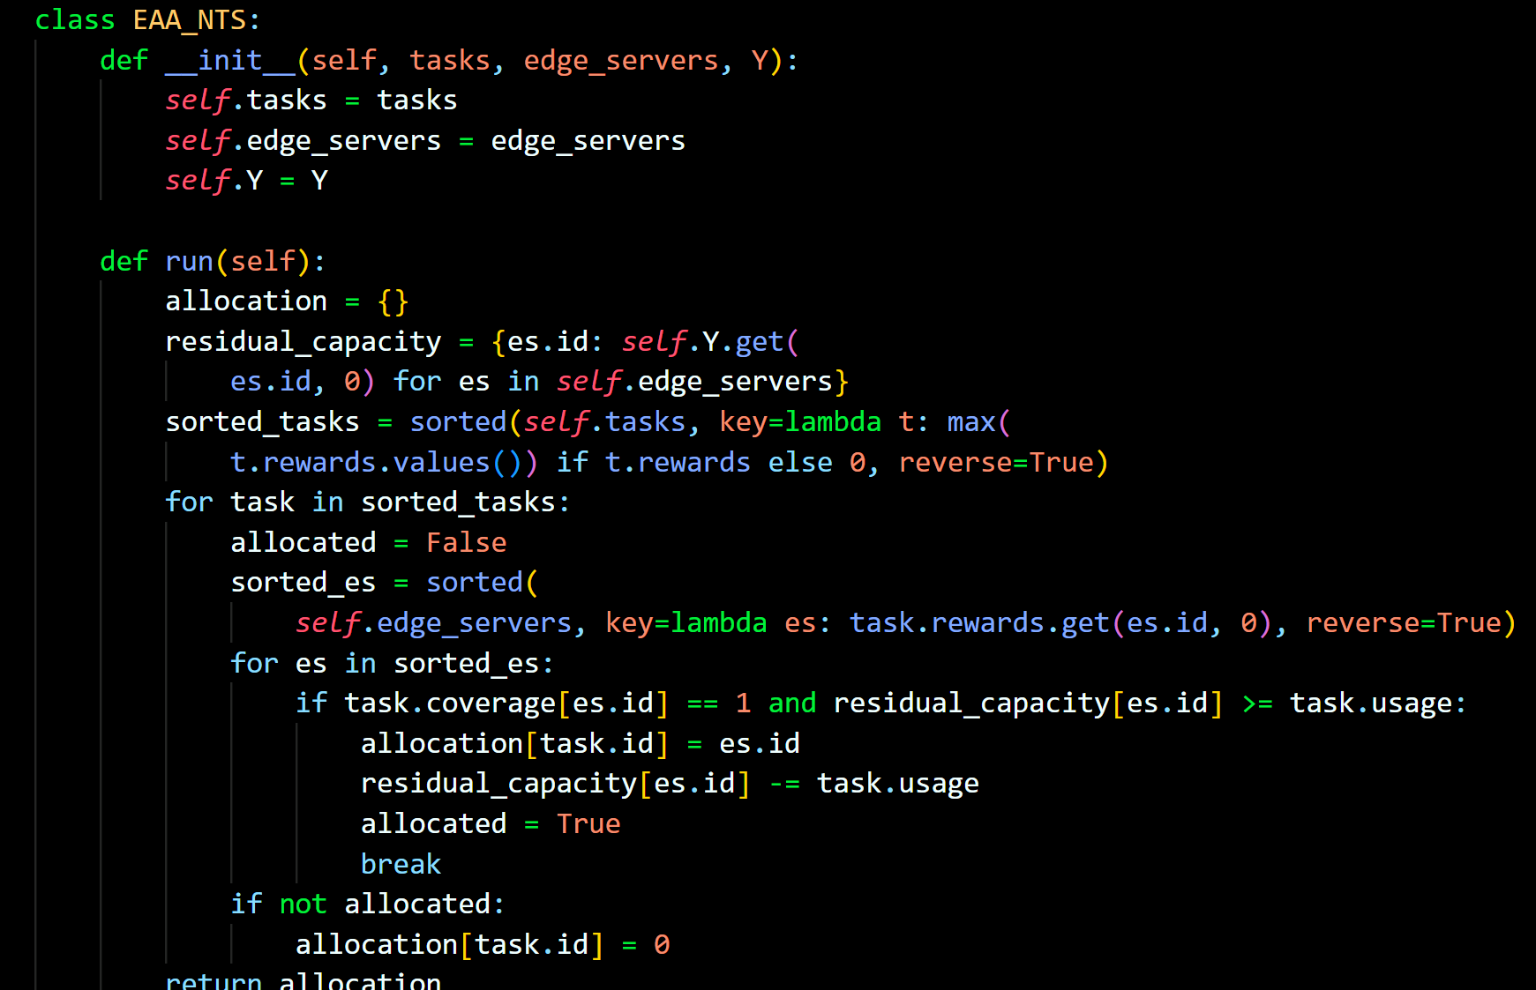
Edge allocation algorithm(nts)
What the code does (EAA-NTS):
Step 1: Initializes tasks, edge servers, and utilization caps (Y).
Step 2: Sorts tasks by their highest possible reward (greedy priority).
Step 3: For each task:
Checks candidate edge servers where it can run.
Prefers the server giving highest reward (reward-oriented).
Allocates only if server has enough residual capacity (respecting utilization cap Y).
Step 4: If no server can host it, the task is assigned to 0 (meaning dropped/not allocated).
Step 5: Returns the final task-to-server allocation.
$2 Billion
Few competitors
Specifically targeted market
Serviceable obtainable market

Slide 15
Main.py
Function by function explanation:
__init__ – Initializes power budget, prepares lists for edge servers and tasks, and creates empty utilization limits (Y).
setup_environment – Builds the network:
Creates random base stations with coordinates and coverage.
Creates edge servers with random capacity & power models.
Links each server to a base station.
power_function – Estimates energy use of a server at different utilizations using interpolation of power coefficients.
generate_tasks – Creates tasks with random demand (usage), assigns rewards per server, and sets coverage to all servers.
run_simulation – Core execution:
Runs MUD Algorithm → calculates safe utilization caps (Y).
Runs EAA-TS → allocates tasks using threshold strategy.
Runs EAA-NTS → allocates tasks without thresholds.
Prints results of all strategies.
Main Block – Starts simulation: sets environment, generates tasks, then runs all algorithms.

Slide 16
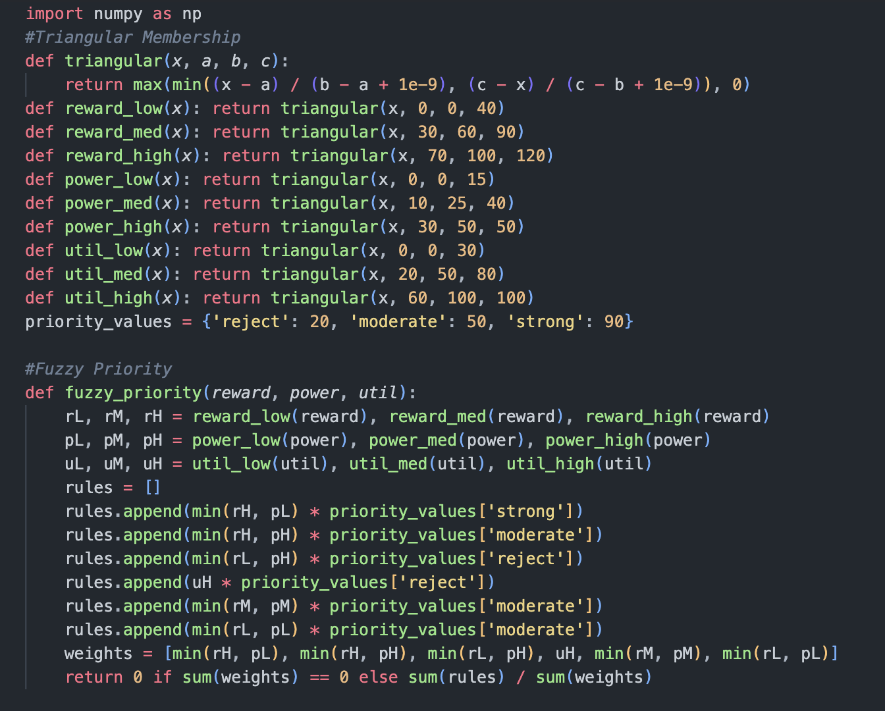
Fuzzy algorithm in phase 1
Membership Function Type:
Uses the triangular membership function, which defines how much each input (reward, power, utilization) belongs to categories like "Low", "Medium", "High".
Returns values between 0 and 1 for each fuzzy set, enabling continuous grading of inputs.
Fuzzification of Inputs:
Inputs for each task and server (reward, power cost, utilization) are mapped into fuzzy categories using the membership functions.
This transforms numeric values into linguistic levels (e.g., "reward is high", "power is low"), supporting soft decision-making.

Slide 17
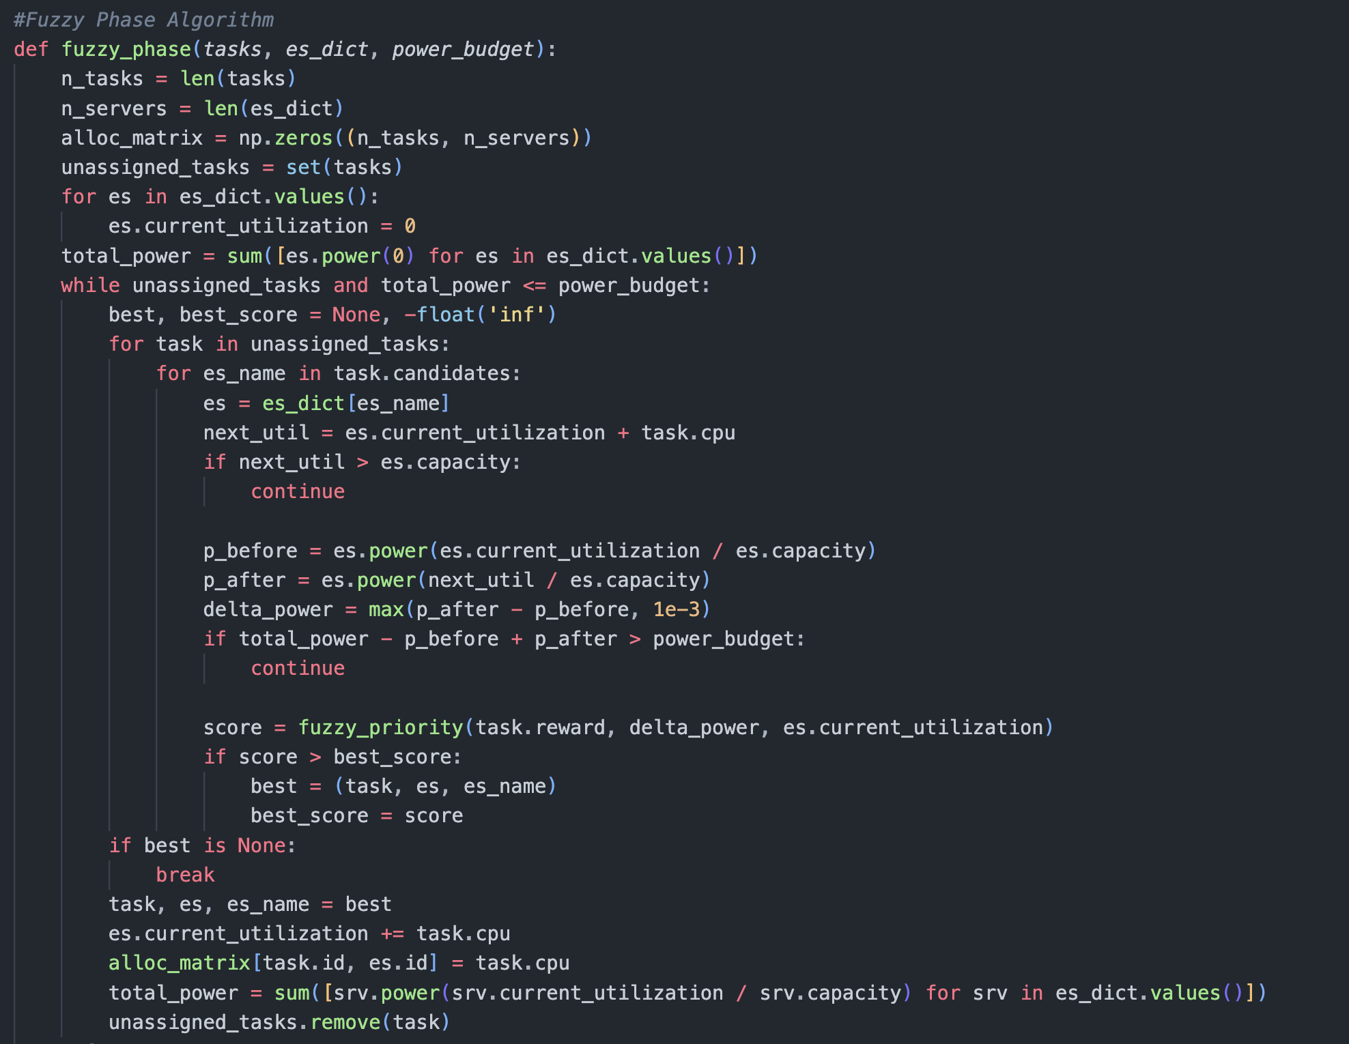
Priority Values for Decision-Making:
Fuzzy rule outputs are mapped to crisp priority values ("strong", "moderate", "reject") for actionable scoring.
Numerical priority scores enable aggregation, comparison, and selection among server-task options.
Defuzzification and Allocation:
The algorithm computes a weighted average of all rule outputs to obtain a final score for each allocation candidate.
The highest-scoring server-task assignment is chosen, subject to power and capacity constraints.

Slide 18
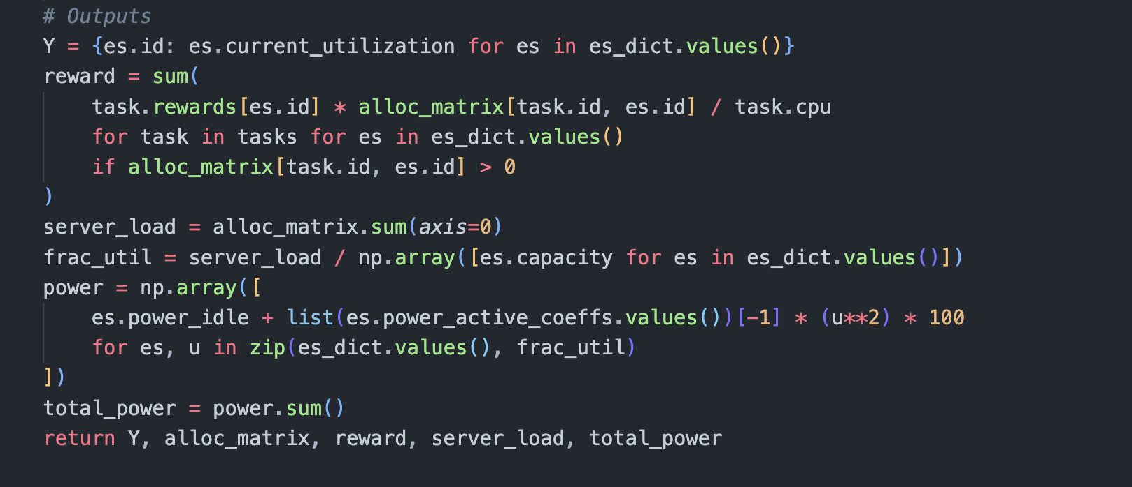
The fuzzy output provides a weighted and adaptive decision by translating linguistic rules and uncertain input data into actionable numerical scores through defuzzification. This enables the allocation process to balance reward, power cost, and server utilization more flexibly than traditional threshold-based algorithms. As a result, resource assignment is optimized under constraints, leading to improved efficiency and utilization in complex systems
Priority Rules
If Reward is High AND Power is Low → Priority = Strong
If Reward is High AND Power is High → Priority = Moderate
If Reward is Low AND Power is High → Priority = Reject
If Utilization is High → Priority = Reject
If Reward is Medium AND Power is Medium → Priority = Moderate
If Reward is Low AND Power is Low → Priority = Moderate

Slide 19
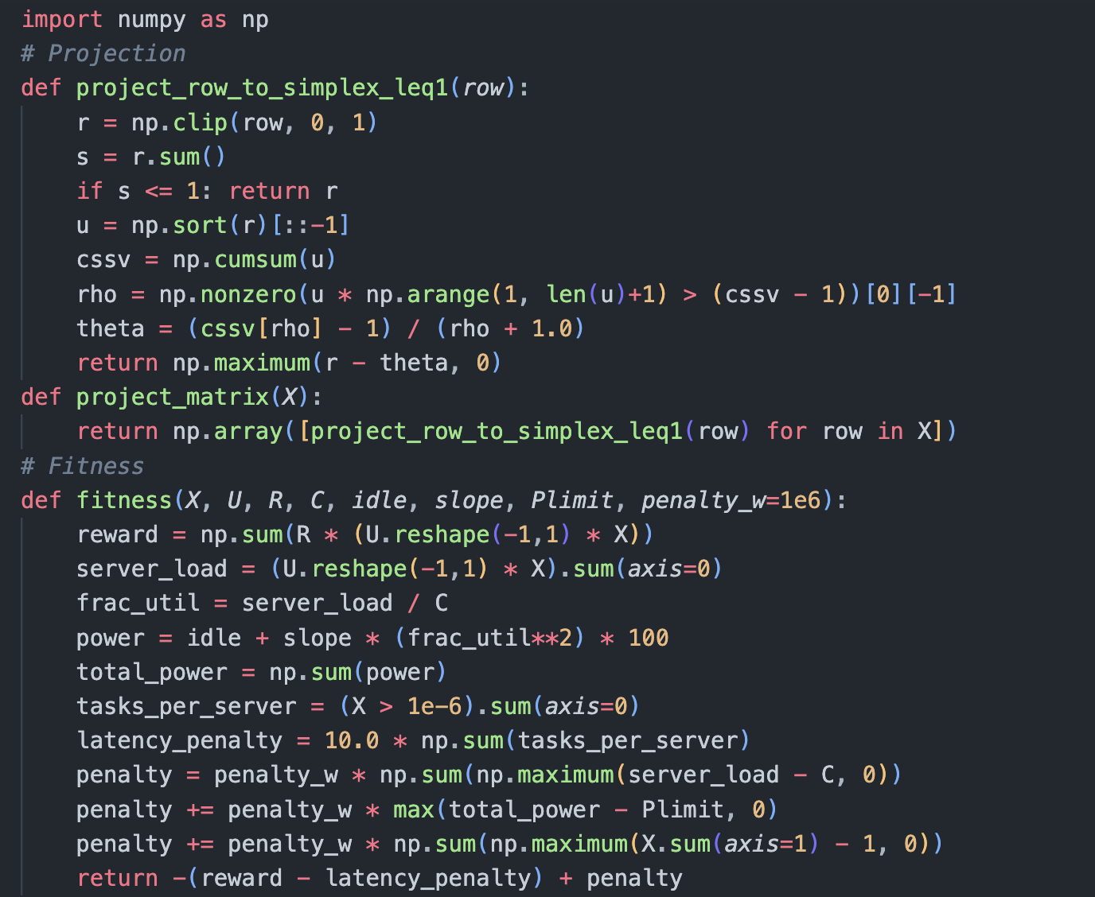
CI in phase 2
Particle Swarm Optimization (PSO) for EAA-TS
Nature-inspired metaheuristic based on bird flocking & fish schooling.
Works with a swarm of candidate solutions (particles).
Workflow:
Initialize Swarm
Random allocations of tasks to servers.
Each allocation projected to satisfy ∑alloc ≤ 1 (per task).
Evaluate Fitness
Reward = Σ (R[i,j] × U[i] × X[i,j])
Apply penalties for:
Capacity violations
Power budget breach
Multiple-server over-assignment

Slide 20
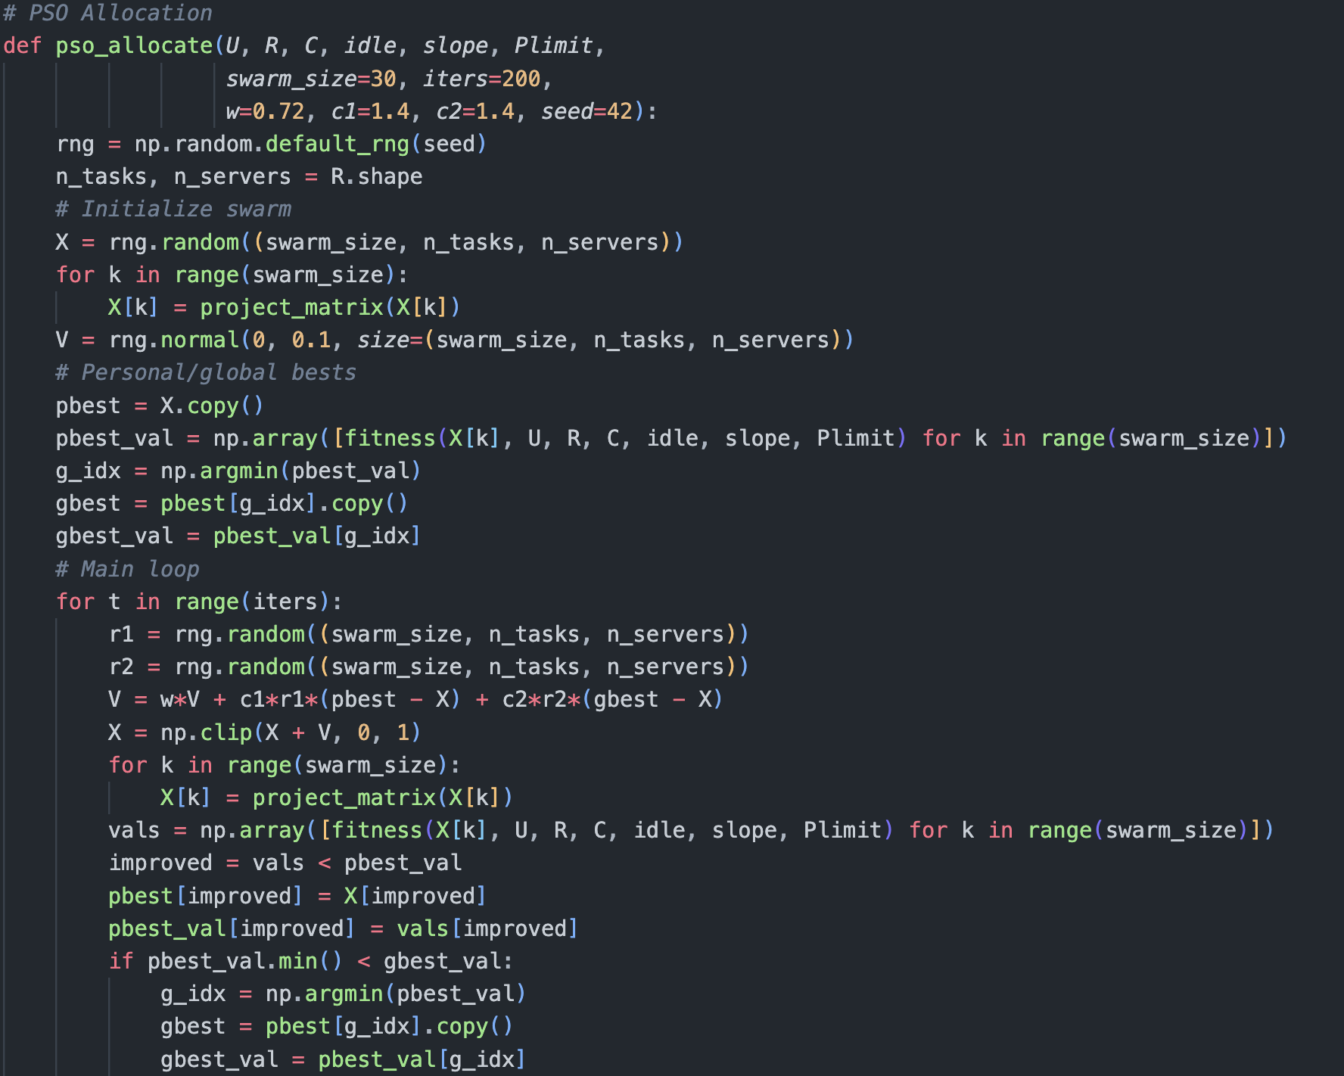
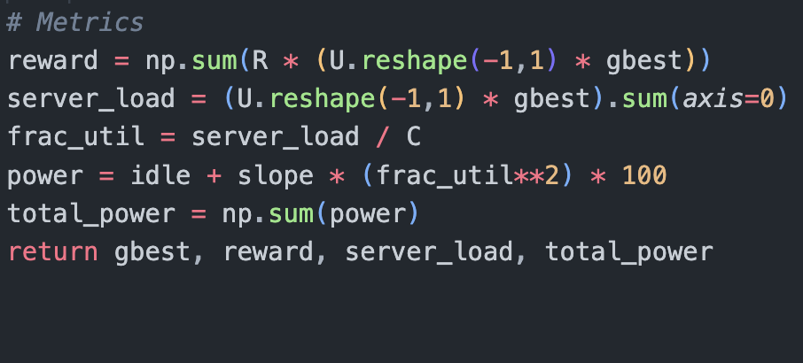
Update Bests
Each particle remembers personal best (pbest).
Swarm tracks global best (gbest).
Velocity & Position Update
Iterate until convergence.

Slide 21
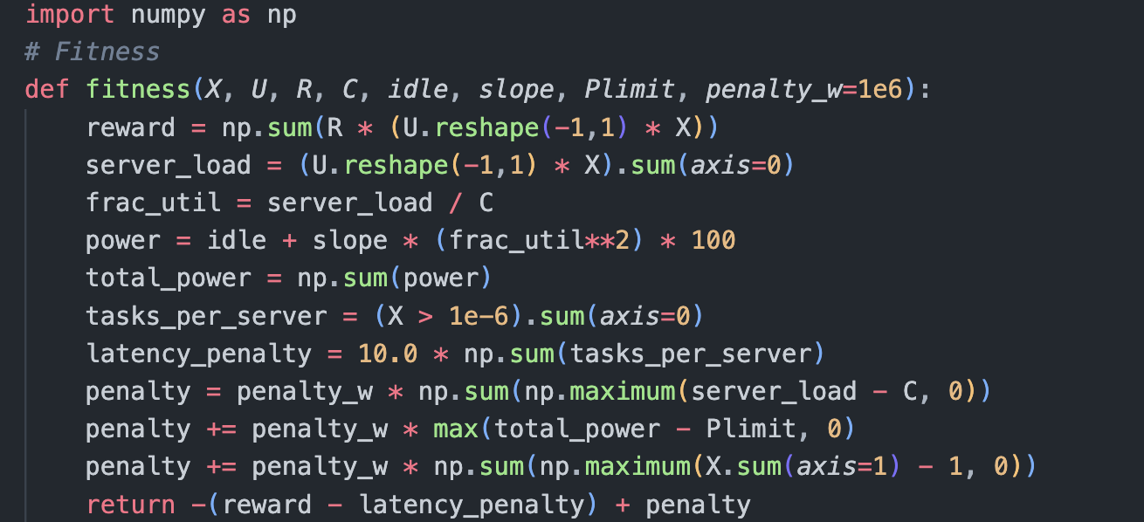
Ant Colony Optimization (ACO) for EAA-NTS
Nature-inspired metaheuristic based on ants finding shortest paths via pheromone trails.
Uses a population of artificial ants to explore allocation possibilities.
Each ant builds a solution by assigning tasks to servers sequentially.
Workflow
Initialize Pheromone Trails
Equal pheromone on all task–server edges.
Heuristic = reward / server capacity.
Construct Solutions
Each ant assigns tasks to servers based on:
Infeasible servers masked out.
Evaluate Fitness
Reward – penalties (capacity violation, power violation, latency).
Update Pheromone
Evaporation (ρ).
Reinforcement from elite/best ants.
Iterate until convergence.

Slide 22
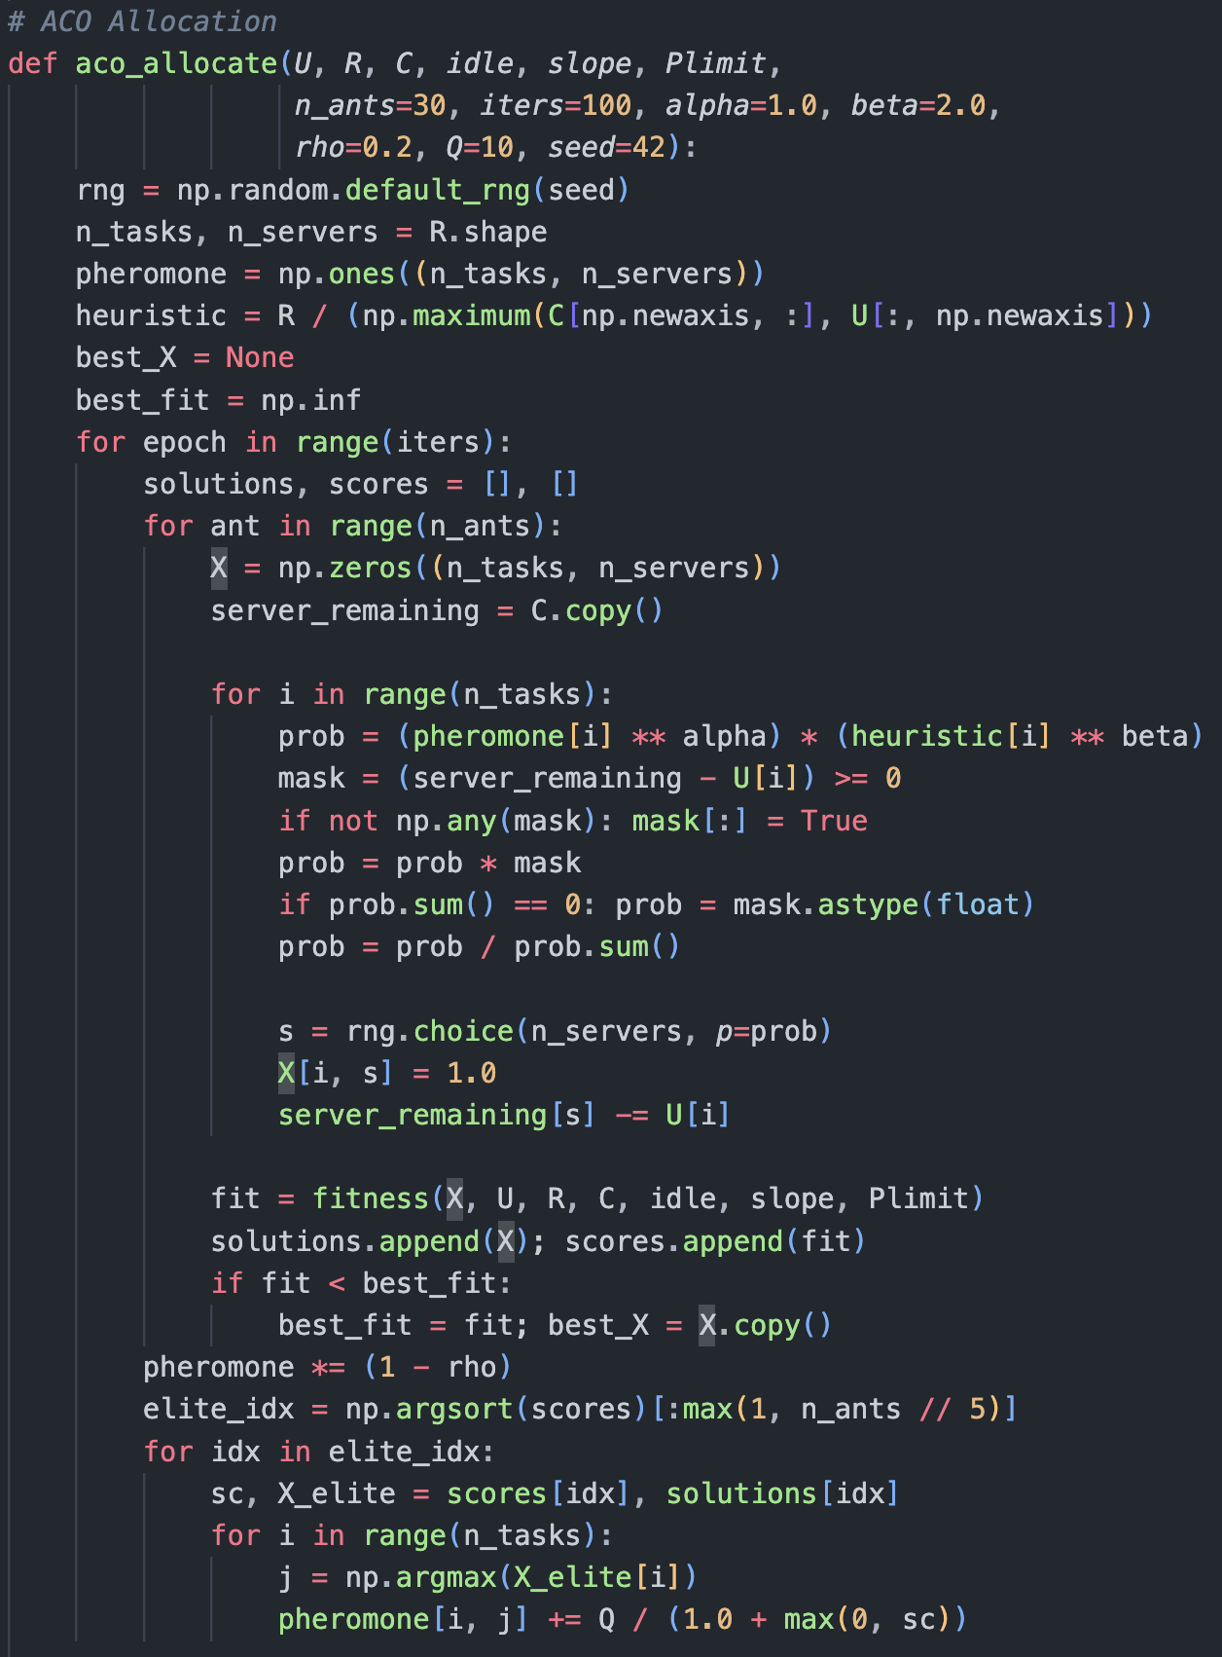
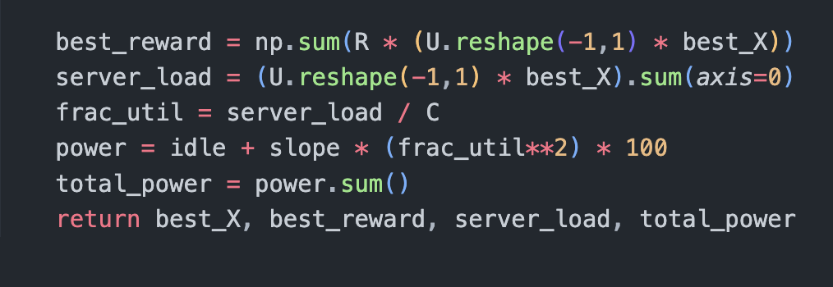

Slide 23
Why Computational Intelligence (CI) Approach is Good
Global Search – CI (PSO/ACO) explores entire solution space, not stuck in local optima.
Flexibility – Can handle both splitting (PSO) and non-splitting (ACO) allocation naturally.
Multi-factor Optimization – Considers reward, power, and utilization simultaneously.
Scalability – Works well as number of tasks/servers grows (large combinatorial spaces).
Adaptability – Can adjust to dynamic workloads or changing power budgets.
Closer to real-world decision-making – mimics adaptive, heuristic human reasoning (e.g., fuzzy logic).

Slide 24
Advantages of CI in Task Offloading
Better Performance under Constraints – Especially effective at low power budgets (tight Plimit).
Supports Complex Scenarios – Nonlinear power models, heterogeneous rewards, large tasks.
Improved Resource Utilization – PSO enables fractional allocation (splitting), maximizing server usage.
Resilience – Handles uncertainty/noise in rewards or workloads.
Extensibility – Can easily include extra objectives (latency, fairness, cost).

Slide 25

THANK YOU

